Slide 1
Technical Support (420-1N6-AB) User Profiles, Registries and Maintenance
Fall 2022

Slide 2
Control Panel
In the search box next to Start on the taskbar, type control panel. Select Control Panel from the list of results.
The control panel is a component of Windows since Windows 1.0
It provides the functionality to view and modify the system settings

Slide 3
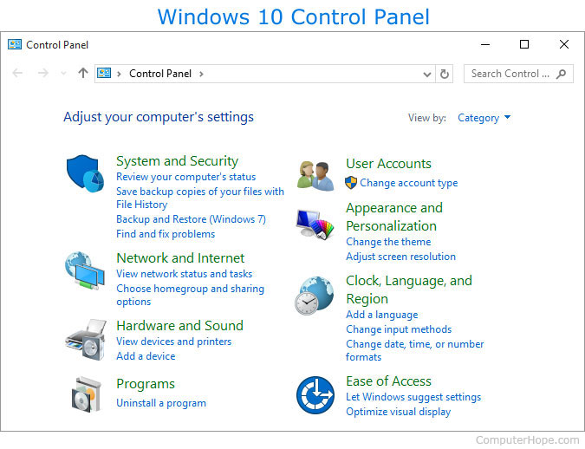
The features you should know about
System and Security:
Allows you to enable/disabled Windows defender firewall.
Block certain apps from accessing your device
Allowing certain apps only when you are connected on a private network, etc.

Slide 4
The features you should know about
Network and Internet:
Allows you to view and modify your network settings namely your adapter settings
You can view your Ip address and modify it
The Ip address is what identifies you on a network.

Slide 5
The functions you should know about
Hardware & Sound:
Allow you to view all the devices connected to your pc.
Allows you to add a device
Allows you to view and modify the device drivers

Slide 6
The functions you should know about
Programs:
Allows you to view the installed software applications on your PC
Allows you to remove applications

Slide 7
The features you should know about
Ease of Access:
Allows you to personalize the icon and text size to facilitate the use of the device.

Slide 8
The functions you should know about
Appearances and Personalization:
Display settings and themes
Clock, Language & Region:
Allows you to set the date and time
Allows you to modify, remove and add keyboard languages
Windows 11: Language can only be set in the Settings

Slide 9
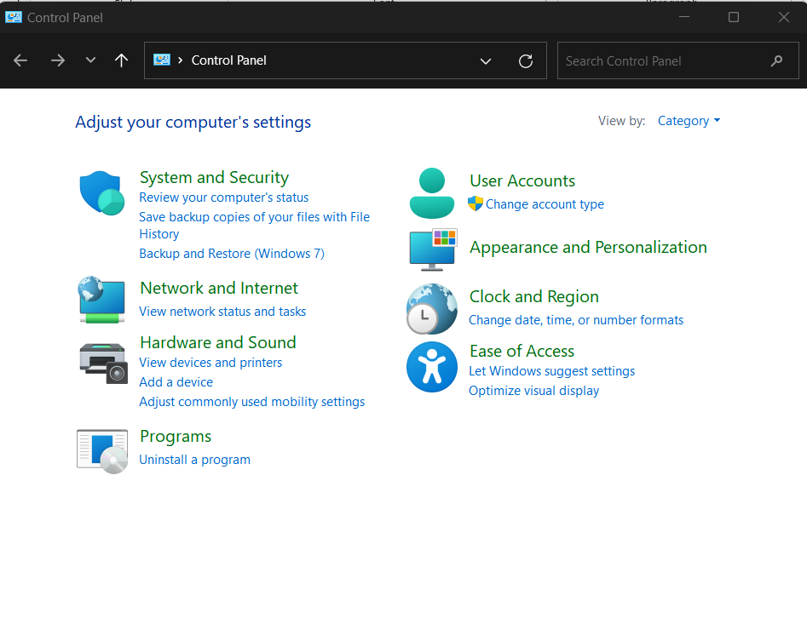
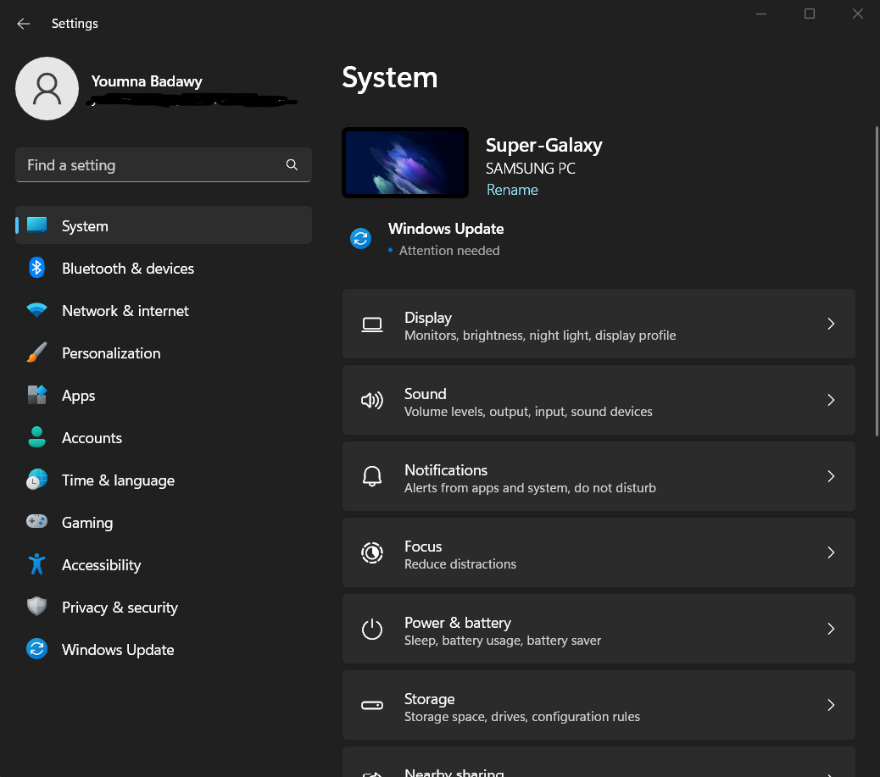
Control Panel vs Settings
Windows 11: Functionalities of the Control Panel have been reduced
Microsoft is slowly eliminating the control panel and its functionalities in the Settings and other places

Slide 10
The functions you should know about

Slide 11
User Profiles

Slide 12
Domain vs Workgroup
Workgroup (Default setting in Windows OS)
All computers are peers; no computer has control over another computer.
Each computer has a set of local user accounts. To log on to any computer in the workgroup, you must have an account on that computer.
Typically a workgroup has less than twenty computers.
A workgroup is not protected by a password.
All computers must be on the same local network to access the other computers.
Domain
Contains at least one server: used to control security and permissions for all computers on the domain.
A user domain account allows a user to log on to any computer on the domain without needing an account on that computer.
Domain users must provide a password or other credentials each time they access the domain.

Slide 13
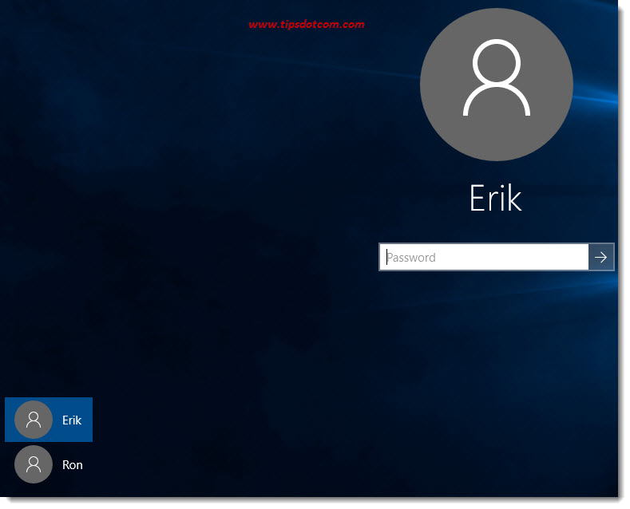
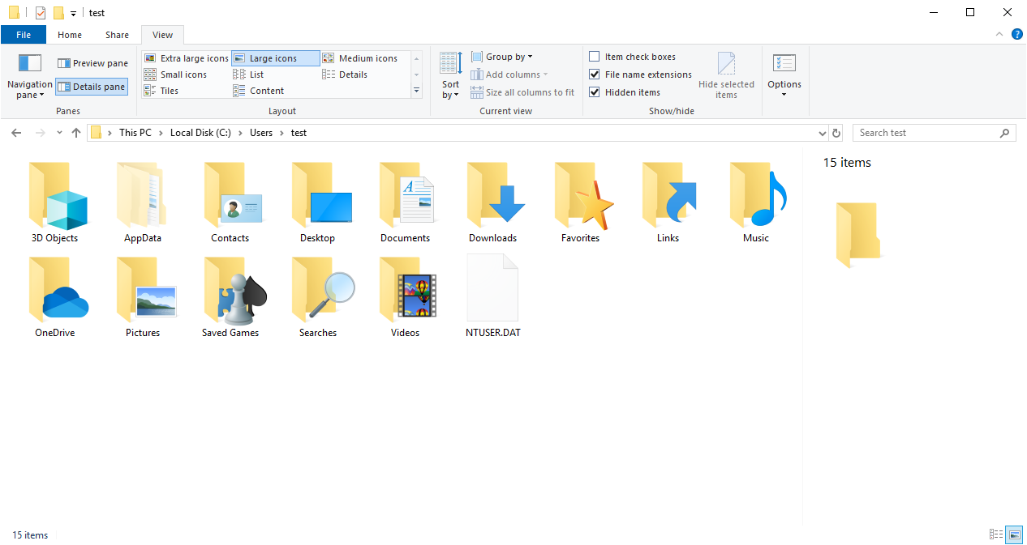
User Profiles
A user profile is created the first time a user logs into a computer.
During subsequent logins, the system loads the user's profile and configures the computer environment according to the information stored in the user profile.

Slide 14
Activity on VM: Adding a Second User Profile
Start > Control Panel
User Accounts > Manage Other Account
Add a user account: French User
Using Microsoft Account
Without a Microsoft Account
Add a second user account: Big Boss:
Without Microsoft Account
Select the newly created account and change account type:
Local Administrator

Slide 15
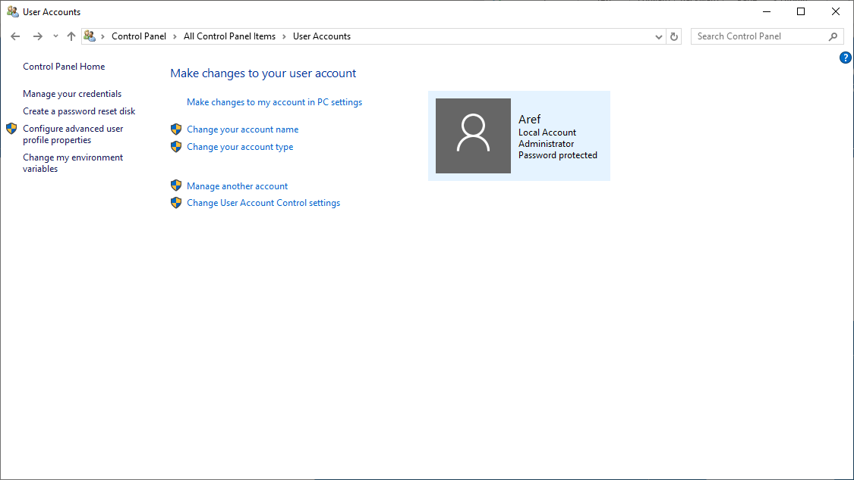
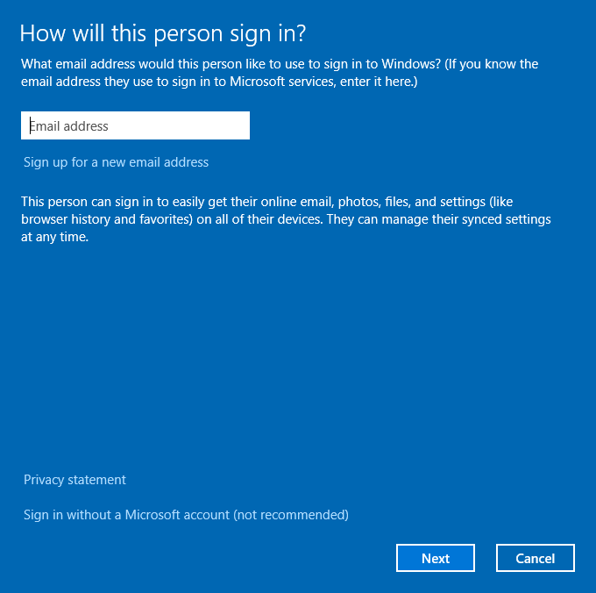
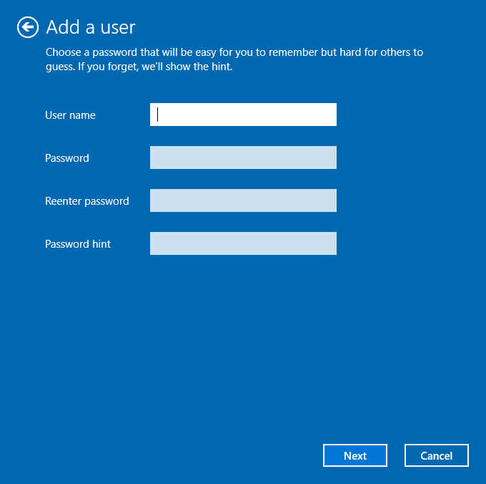
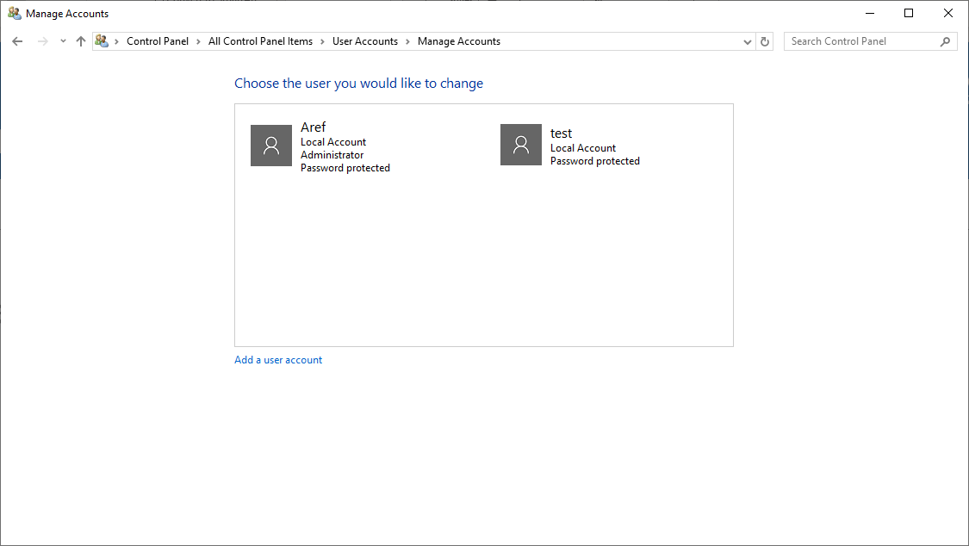
Activity on VM: Adding a Second User Profile

Slide 16
Activity on VM: Changing the Local Profile Language
Login to second account.
Type settings in the search area on the task bar and select Settings.
Select Time and language.
Select Region and Language from the left panel.
Click on Add language.
Add desired language from the given list (French Canada).
Click on the French language and click on Set as Default button.

Slide 17
Handling User Profiles
A user profile consists of the following:
Registry hive loaded by the system when the user logs in. HKEY_CURRENT_USER key stores user preferences and configuration.
A set of folders stored in the file system.
Containers for applications and other system components to populate with sub-folders and user-specific data such as documents and config files.

Slide 18
Types Of Profiles
Local Profile
A local user profile is created the first time a user logs onto a computer.
This is stored on the computer's hard drive.
Changes are specific to user and computer on which the changes are made.
Roaming Profile
A copy of the local profile that is copied to and stored on a shared server.
This is downloaded to any computer within the network that the user logs into.
Changes to a roaming profile are saved to the server when the user logs off.

Slide 19
Types Of Profiles (2)
Mandatory Profile
Administrators can create mandatory user profiles with settings for users.
These settings can only be changed by the administrator.
Any changes made to the profile by the user are lost once the user logs off.
Temporary Profile
A temporary profile is created if an error prevents user profile from loading.
These profiles are deleted automatically at the end of each session.
Any changes made to the profile by the user are lost once the user logs off.

Slide 20
Advantages Of User Profiles
When the user logs onto a computer, the system uses the same settings that were in use when the user last logged off.
When sharing a computer with other users, each user receives their own customized desktop after logging on.
Settings in the user profile are unique to each user and cannot be accessed by other users.
Changes made to one user's profile do not affect other users or their profiles.

Slide 21

Password Reset Disk
Can only be created for a local user account (only needs to be done once).
Requires a USB flash drive or SD Card (you cannot use CD or DVD).
Control Panel → User Accounts → Create a password reset disk.

Slide 22
File Permissions

Slide 23
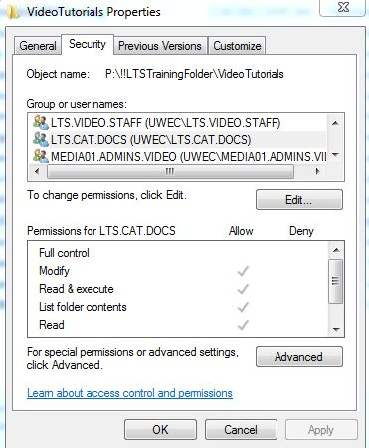
File Permissions
The properties tab of files and folders in Windows allows you to configure various permissions for the different users or groups of users

Slide 24
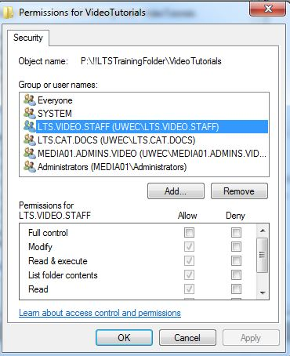
File permissions
You may Edit permission:
These are the NTFS permissions:
Full Control (includes everything)
Modify (does not include taking ownership)
Read and Execute (view files and run apps)
List Folder contents (view folders but not access files
Read (open and view files)
Write (create folder and files and edit them)

Slide 25
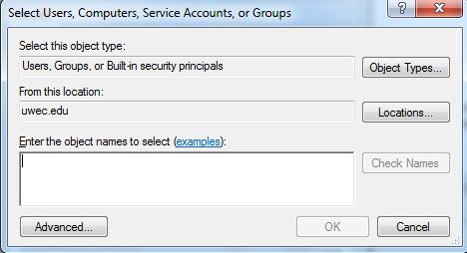
File permissions – Add a user
Click the Edit button, this opens a new window
Click the Add button, you may type the name of the user: FrenchUser or Click on Advanced > Add to add the user.

Slide 26
Windows Registry

Slide 27
Windows Registry
Huge database that stores everything about the PC including information on all the hardware, network information, user preferences file types and practically everything you find in Windows.
Every version of Windows stores Registry files called hives in the \%SystemRoot%\System32\ config folder and each user account folder.
Computer technicians should:
Understand basic Registry components,
Know how to edit the Registry manually,
Know the best way to locate a particular setting.

Slide 28
Accessing Registry
To access the Registry, type “regedit” in the Start 🡪 Search bar (or Spotlight).
The Registry is organised in a tree structure similar to the folders in a file system.
It shows keys (or subkeys) on the left and values on the right.

Slide 29
Activity VM: Inspect the registries
To access the Registry, type “regedit” in the Start 🡪 Search bar (or Spotlight).

Slide 30
Activity VM: Five main subgroups or root keys
HKEY_CLASSES_ROOT | Historically this root key defined the standard class objects used by Windows. Now this root key provides backwards compatibility for older applications.
HKEY_CURRENT_USER HKEY_USERS | These store personalized information for each user that has an account on the system such as desktop colours, screensavers and desktop contents.
HKEY_LOCAL_MACHINE | Contains all the data for a system’s non-user-specific configurations. This encompasses every device and every program in your computer.
HKEY_CURRENT_CONFIG | If the values in HKEY_LOCAL_MACHINE have more than one value, e.g. two different monitors, this root key defines which one is currently being used.

Slide 31
Activity VM: Using Registry Editor
When you use the Registry Editor to access the Registry, you risk breaking things.
Applications might not start, utilities may not work, or your computer may not boot.
Always make a backup of the Registry (preferably into a thumb drive) before you change anything. After you make the change, reboot the system to see if it had the desired effect. If not, restore the old Registry settings from your backup.

Slide 32
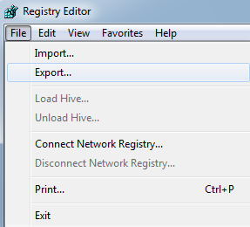
Activity VM: Using Registry Editor
To save a copy of the Registry,
Export the full registry or a single key or subkey (with all subkeys and values under it) using File → Export.
Saved with the extension .reg
To restore a set of backed up registry keys,
Use File → Import or right-click on the icon and select Merge.

Slide 33
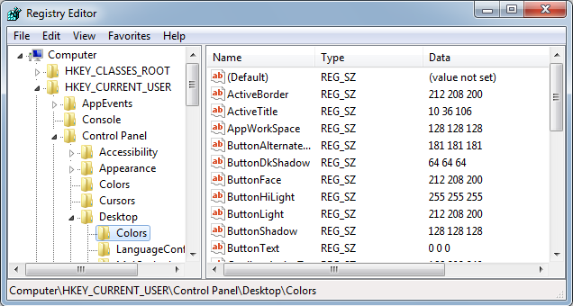
Activity VM: Using Registry Editor

Slide 34
Activity VM: Change highlight color
Press the Windows key + R to open the Run dialog box.
Type "regedit" (without quotes) and press Enter to open the Registry Editor.
Navigate to HKEY_CURRENT_USER\Control Panel\Colors.
Look for the "Hilight" value in the right-hand pane. This is the value that controls the highlight color of selected items.
Double-click on "Hilight" to open its properties.
In the "Value data" field, enter the RGB value of the color you want to use. For example, if you want to use a light blue color, you can enter "192 217 255" (without quotes).
Click OK to save the changes.
Close the Registry Editor.
More registries hacks: https://www.minitool.com/backup-tips/windows-10-registry-hacks.html

Slide 35
OS Maintenance

Slide 36
Preventative Maintenance Tasks
Disk cleanup.
Disk defragmentation.
Hard drive error checking.
Updates to OS (e.g. service packs) and applications.
Updates to antivirus and other protective software.

Slide 37
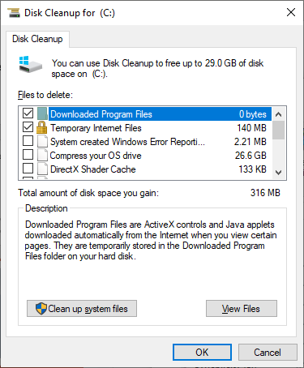
Disk Cleanup
Removes unneeded files e.g.
Temporary internet files
Files downloaded to install programs
Files in the recycle bin
Log files
Temporary files
Thumbnails
Admin can also clean up system files.

Slide 38
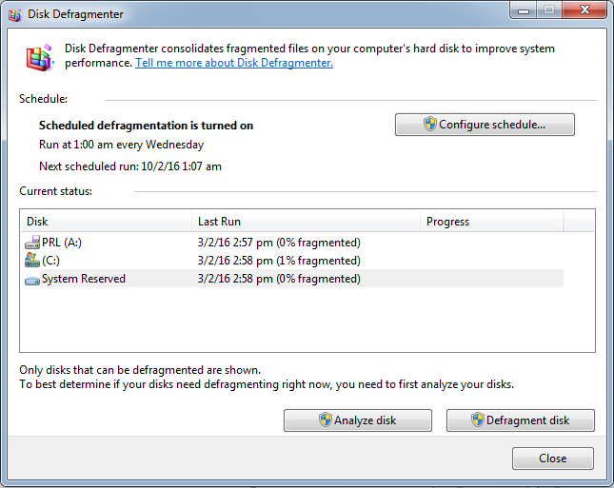
Disk Defragmentation
If a storage device is fragmented, it can slow down your computer.
A disk can become fragmented very quickly if it is used heavily and data is written to it often.
Disk defragmenter typically runs on a schedule but you can analyze and defrag manually.

Slide 39
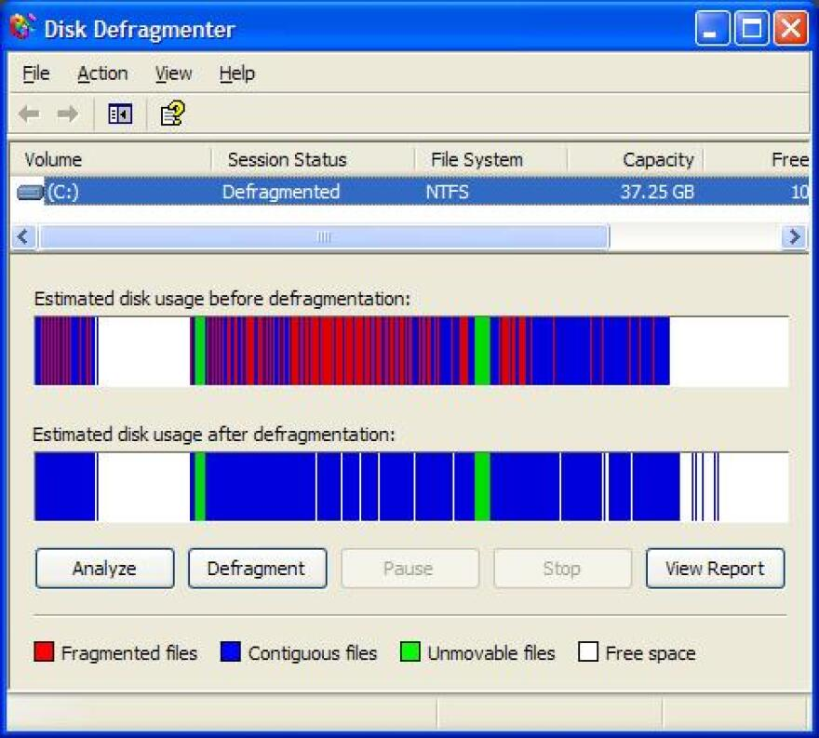
Disk Defragmentation
On older versions of Windows, the defragmenter came with a visualization tool..

Slide 40
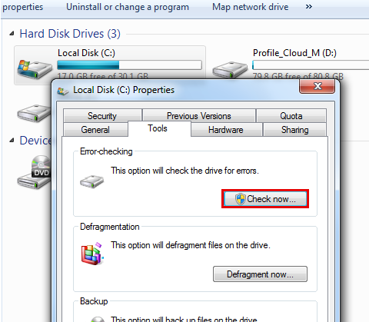
Hard Drive Error Checking
The Disk Check tool in Windows can find and repair file system errors on:
Local hard drives.
Removable media such as USB flash drives or memory cards.

Slide 41
OS Maintenance – OS updates

Slide 42
Updates to OS and applications
A service pack is a collection of updates, fixes or enhancements to a software program, delivered in the form of a single installable package. They may introduce new features to an OS as well as bug fixes, security enhancements, etc.
It is common to have service packs issued within the first two years of release of a product, and they are usually numbered, e.g. SP1, SP2.
Note: Microsoft recommends that you never be more than two service packs behind.

Slide 43
OS Maintenance – final notes

Slide 44
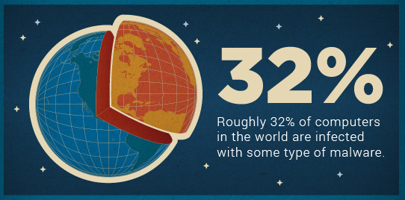

Updates to antivirus and other protective software
Antivirus software must be updated regularly to stay effective against new viruses.
This can be handled automatically by the software or manually by the user.

Slide 45
Q & A

